Slide 1
Case Study: Searching for Patterns
Problem: find all occurrences of pattern P of length m inside the text T of length n.
⇒ Exact matching problem

Slide 2
String Matching - Applications
Text editing
Term rewriting
Lexical analysis
Information retrieval
And, bioinformatics

Slide 3
Exact matching problem
Given a string P (pattern) and a longer string T (text).
Aim is to find all occurrences of pattern P in text T.
The naive method:
T
a
g
c
a
g
a
a
g
a
g
t
a
g
a
g
a
g
a
g
g
a
g
g
a
g
a
g
a
g
g
g
a
g
a
g
a
g
a
g
g
a
g
g
a
g
a
g
a
g
g
g
a
g
a
g
a
g
a
g
a
g
a
g
g
a
g
g
a
g
a
P
g
g
g
P
a
g
a
g
a
g
g
P
P
P
P
P
a
g
If m is the length of P, and n is the length of T, then
Time complexity = O(m.n),
Space complexity = O(m + n)

Slide 4
Can we be more clever ?
When a mismatch is detected, say at position k in the pattern string, we have already successfully matched k-1 characters.
We try to take advantage of this to decide where to restart matching
T
a
g
c
a
g
a
a
g
a
g
t
a
g
a
g
a
g
a
g
g
a
g
g
a
g
a
g
a
g
g
a
g
g
a
g
a
g
a
g
g
P
g
a
g
a
g
a
g
a
g
g
g
a
g
a
g
a
g
a
g
g
P
P
a
g
P
P

Slide 5
The Knuth-Morris-Pratt Algorithm
Observation: when a mismatch occurs, we may not need to restart the comparison all way back (from the next input position).
What to do:
Constructing an array h, that determines how many characters to shift the pattern to the right in case of a mismatch during the pattern-matching process.

Slide 6
KMP (2)
The key idea is that if we have successfully matched the prefix P[1…i-1] of the pattern with the substring T[j-i+1,…,j-1] of the input string and P(i) ≠ T(j), then we do not need to reprocess any of the suffix T[j-i+1,…,j-1] since we know this portion of the text string is the prefix of the pattern that we have just matched.

Slide 7
The failure function h
For each position i in pattern P, define h_{i} to be the length of the longest proper suffix of P[1,…,i] that matches a prefix of P.
i = 11
1
2
3
4
5
6
7
8
9
10
11
12
13
Pattern:
a
b
a
a
b
a
b
a
a
b
a
a
b
Hence, h(11) = 6.
If there is no proper suffix of P[1,…,i] with the property mentioned above, then h(i) = 0
.

Slide 8
The KMP shift rule
The first mismatch in position
k=12 of T and in pos. i+1=12 of P.
T:
a
b
a
a
b
a
b
a
a
b
a
c
a
b
a
a
b
a
b
a
a
b
P:
a
b
a
a
b
a
b
a
a
b
a
a
b
P:
a
b
a
a
b
a
b
a
a
b
a
a
b
h₁₁ = 6
Shift P to the right so that P[1,…,h(i)] aligns with the suffix T[k- h(i),…,k-1].
They must match because of the definition of h.
In other words, shift P exactly i – h(i) places to the right.
If there is no mismatch, then shift P by m – h(m) places to the right.

Slide 9
The KMP algorithm finds all occurrences of P in T.
First mismatch in position
k of T and in pos. i+1 of P.
Suppose not, …
T:
P before shift
β
β
P after shift
missed occurrence of P

Slide 10
Correctness of KMP.
First mismatch in position
k of T and in pos. i+1 of P.
T(k)
T:
α
P before shift
β
P after shift
β
α
missed occurrence of P
|α| > |β| = h(i)
It is a contradiction.

Slide 11
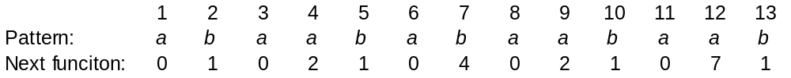
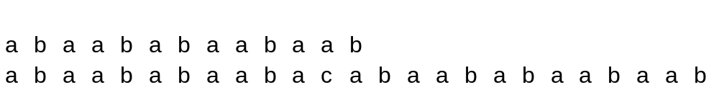
An Example
Given:
Array h: 0 0 1 1 2 3 2 3 4 5 6 4 5
Input string:
i+1 = 12
Scenario 1:
k = 12
What is h(i)= h(11) = ?
h(11) = 6 ⇒ i – h(i) = 11 – 6 = 5
Scenario 2:
i = 6 , h(6)= 3
i+1
k

Slide 12
An Example
Scenario 3:
i = 3, h(3) = 1
i+1
k
Subsequently
i = 2, 1, 0
Finally, a match is found:
i+1
k

Slide 13
Complexity of KMP
In the KMP algorithm, the number of character comparisons is at most 2n.
After shift, no character will be
no backtrack
compared before this position
T:
P before shift
P after shift
In any shift at most one comparison involves a character of T that was previously compared.
Hence #comparisons ≤ #shifts + |T| ≤ 2|T| = 2n.

Slide 14
Computing the failure function
We can compute h(i+1) if we know h(1)..h(i)
To do this we run the KMP algorithm where the text is the pattern with the first character replaced with a $.
Suppose we have successfully matched a prefix of the pattern with a suffix of T[1..i]; the length of this match is h(i).
If the next character of the pattern and text match then h(i+1)=h(i)+1.
If not, then in the KMP algorithm we would shift the pattern; the length of the new match is h(h(i)).
If the next character of the pattern and text match then h(i+1)=h(h(i))+1, else we continue to shift the pattern.
Since the no. of comparisons required by KMP is length of pattern+text, time taken for computing the failure function is O(n).

Slide 15
Computing h: an example
Given:
1
2
3
4
5
6
7
8
9
10
11
12
13
Failure function h: 0 0 1 1 2 3 2 3 4 5 6
Pattern:
4
5
1
2
3
4
5
6
7
8
9
10
11
12
13
Text:
$
b
a
a
b
a
b
a
a
b
a
a
b
Pattern:
a
b
a
a
b
a
b
h(11)=6
Pattern
a
b
a
a
b
h(6)=3
h(12)= 4 = h(6)+1 = h(h(11))+1
h(13)= 5 = h(12)+1

Slide 16
KMP - Analysis
The KMP algorithm never needs to backtrack on the text string.
preprocessing searching
Time complexity = O(m + n)
Space complexity = O(m + n),
where m =|P| and n=|T|.

